Slide 1
Taxis in the mist: Weather impact on NYC taxi use
Project Proposal – John Blakkan, Rohit Nair, Andrea Pope
W205 - Group Project Proposal

Slide 2
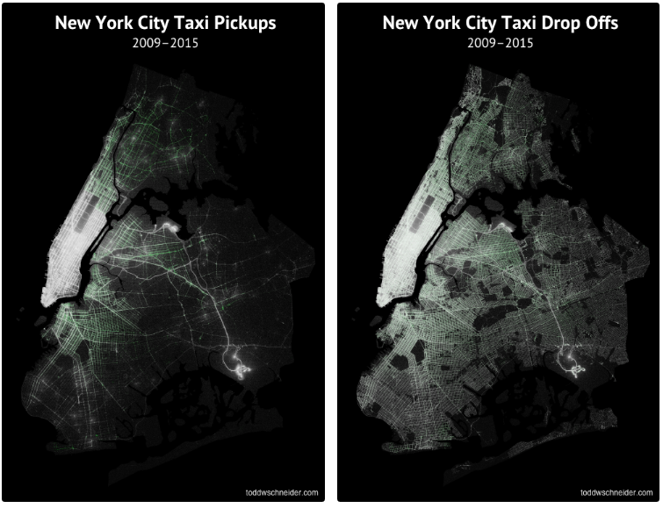
New York City Taxi & Uber Data
The New York City Taxi & Limousine Commission (TLC) released a staggeringly detailed historical dataset covering over 1.1 billion individual taxi trips in the city from January 2009 through June 2015
Everyone knows it is hard to catch a taxi on a rainy day, but are there other trends less well known? How could understanding these trends better improve the number of taxis available and appropriate pricing? As a commuter, what are your best options on bad weather days?

Slide 3
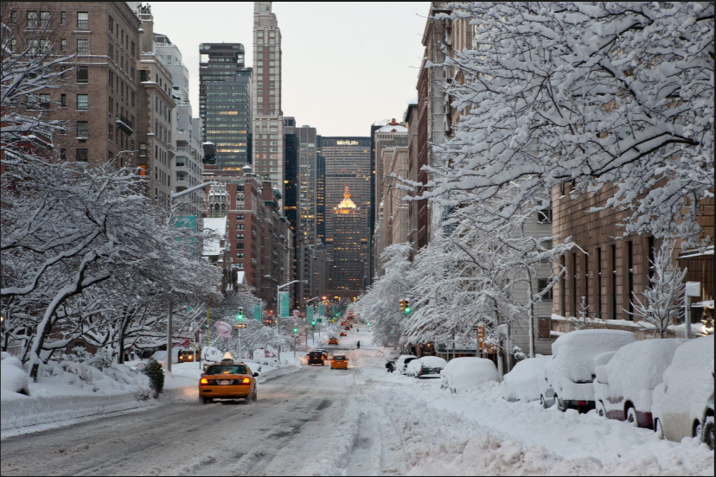
Weather Impacts on NYC Taxi Use
Complementing the NYC TLC data set with available daily and hourly weather data during this same time period, we can look at how weather impacts traveling trends, such as:
How is taxi usage related to weather (temperature, precipitation, wind, …)?
During inclement weather, are short trips or longer trips more prevalent?
Is there a socio-economic impact?
Or is there a type of weather that “evens” socio-economic impacts?
How much is travel impacted by weather vs. money?
What behaviors are most common for beautiful days?
Does seasonality make a difference (e.g. taxis are used more on 50º days in fall, than 50º degree days in the Spring?)
How does passenger count change in different weather?
Social - are people more willing to share a cab?
Financial - should cab companies be using their vans?

Slide 4

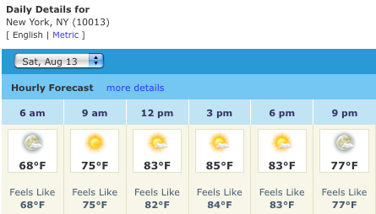
In Data We Trust
Collect
Storage
Meaningful Schema
Report
NYC TLC Data
(many, many files)
Primary
Data Lake
(HDFS)
New York City Weather
Transform to form suitable for reporting
Clean Data
Join/Map Sources
Support investigation and predictions
Steps:
Technology TBD
Reporting /
Dashboards
Source: NOAA - central park station or FAA, LaGuardia
Technology TBD
D3
Tableau
Filter to information most interested
Aggregate
Merge data
Aggregate to level for reporting
Neighborhoods
Socio-Economic
Supplemental
Weather Predictions
…
Extract
Transform
Load
Notes:
Datasets:
http://www.andresmh.com/nyctaxitrips/
http://www.nyc.gov/html/tlc/html/about/trip_record_data.shtml

Slide 5
Challenges
Understanding ethical and moral concerns related to analysis.
Current streaming data source under consideration is predicted/forecasted weather, for use in planning supply and/or price adjustments
Initial research must support claim that taxi/weather usage is related.
If not, we’ll need to investigate another streaming data sources for incorporation into analysis.
Availability of only an year’s worth of overlap between TLC and Uber’s data.
Discontinuous timeframe of Uber data.

Slide 6
Open Questions
Uber’s unlimited UberPool promotion’s effect on the market.
Transformation technology under consideration
SparkSQL, pyspark under consideration
Reporting interface TBD
Tableau and/or D3 under consideration
Gathering Socio-economic data for NYC
Notes:
Unlimited UberPool Promotion: https://www.uber.com/info/plus/newyork/

